Slide 1
Serene Mind Mental HealthCare App
By Naga Shishira , Durva Kamdar, Divy Patel, Gurkirpal Singh, Olivia Alex

Slide 2
INTRODUCTION
It is all too easy for our mental health to be impacted by the stresses and challenges of daily life, and it gets too difficult to take care of our sanity amidst the everyday hustle.
But don’t you worry, we got this covered!
We carefully-designed a self-help app that can help you track your mental health and daily activities to help you not forget to take care of yourself in-between the hectic routine.
Perhaps, it won’t be too hard to have a Serene Mind after all.

Slide 3
01
Intro & Sign-up Screen
You can enter a subtitle here if you need it

Slide 4
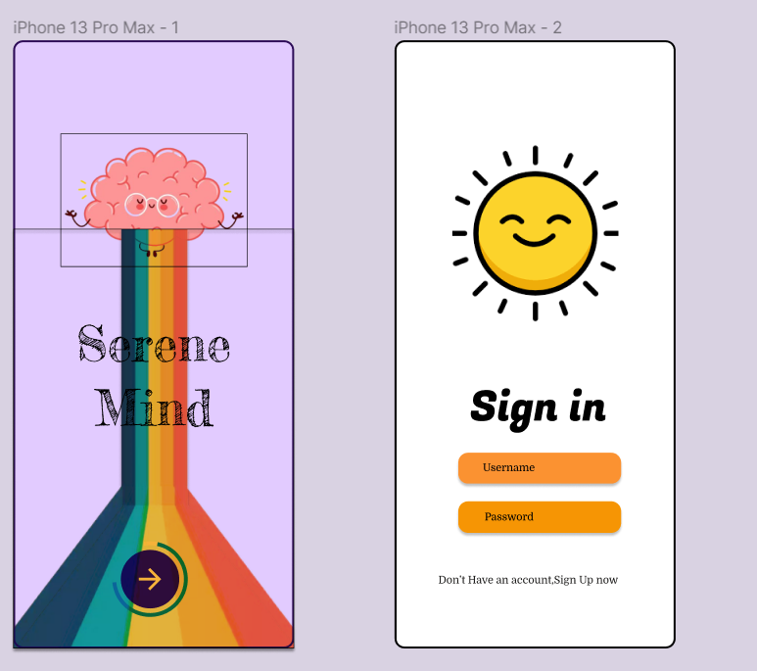

Slide 5
02
Features Screens
You can enter a subtitle here if you need it

Slide 6
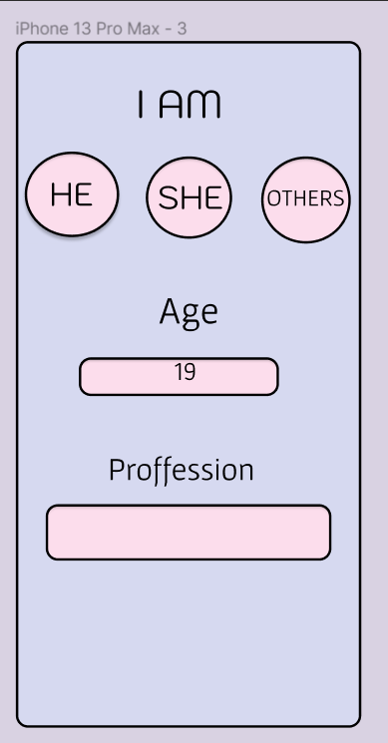
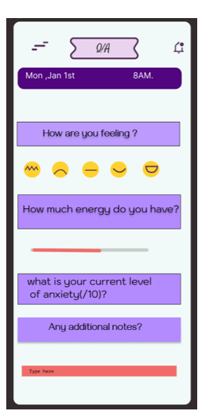

Slide 7
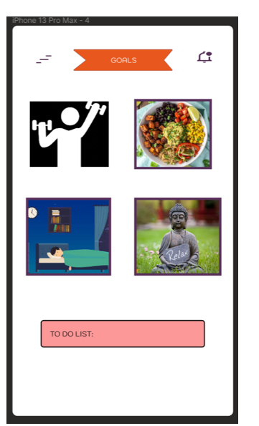
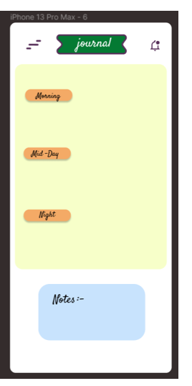

Slide 8
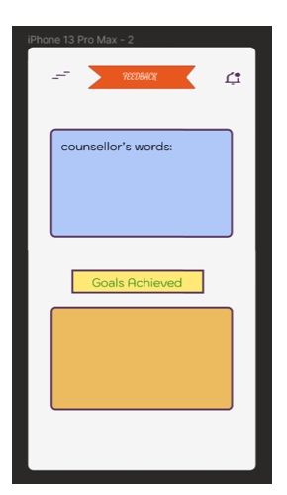
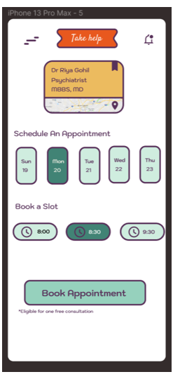

Slide 9
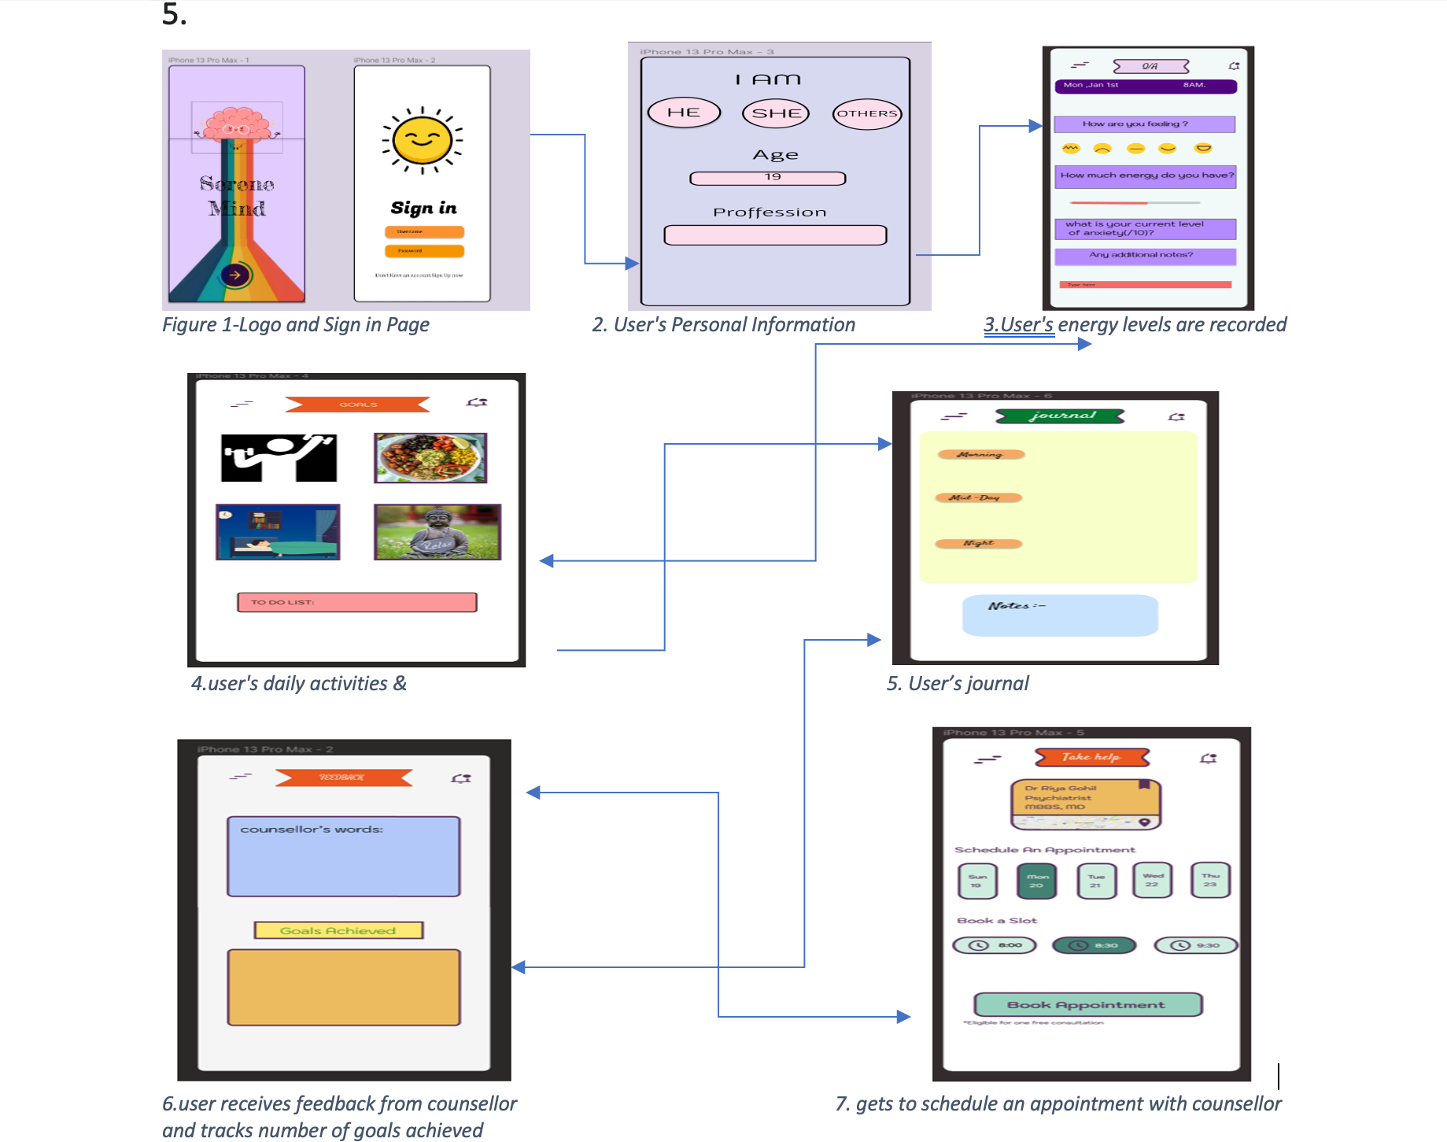

Slide 10
THANKS!
Do you have any questions?
Ask us
Naga Shishira
Durva Kamdar
Divy Patel
Gurkirpal Singh
Olivia Alex

